Slide 1
NORTH SOUTH UNIVERSITY
Lecture 13
PHI 104
Introduction to Ethics

Slide 2
Responsibility: Responsibility towards
Parents & Family

Slide 3
The theories of punishments try to explain and justify punishment by their own viewpoints. There are mainly three theories of punishment which are the deterrent theory which tries to deter crimes by punishing the criminal, retributive theory which aims to attain retribution by punishing the criminal for his or her wrongdoing and finally reformative theory which hopes to reform the character of the criminal by inflicting punishment. Nevertheless, every one of these theories has their own merits and demerits.

Slide 4
What is Responsibility?
Responsibility is a duty or obligation for which a person is held accountable. It is the human condition that people are responsible or held accountable for the things they do or cause to happen, according to certain norms. Responsibility is accompanied by three essential elements:
1) norms that determine accountability,
2) freedom or free will to act as a rational agent, and
3) results that can be either praiseworthy or blameworthy.

Slide 5
Why is responsibility important?
The exercise of responsibility furthers the development of character, bringing forth praiseworthy results; it is the means by which human beings participate in their own creation as moral beings; it is also the way human beings can live in community as social beings. Thus, responsibility endows human beings with value and nobility, as compared with animals that reach their mature form autonomously by the operation of instinct.

Slide 6
In this regard, the major world religions understand responsibility as an important component of the process of liberation or salvation. The philosophical tradition in the West since the time of Socrates, Plato, and Aristotle has treated responsibility as something indispensable in social life.

Slide 7
Responsibility in religious and philosophical traditions
In classical religious and philosophical treatments of responsibility, the three elements of responsibility (that is, norms, freedom, and praiseworthy results) are not arbitrary or accidental, while essential to human beings. They are rather considered to be rooted in a transcendent Reality—dharma, Dao, Heaven, God, Forms, or Unmoved Mover. For example, the reward for praiseworthy conduct, which is liberation (moksha or nirvana), salvation (paradise), or eudaimonia (happiness), is ultimately the Creator-given, either endowed by divine grace or written in the fabric of human nature, revealed in the workings of conscience.

Slide 8
Philosophical Treatment of Responsibility

Slide 9
Norm and Praiseworthiness
Responsibility is an important topic in philosophy. It is dealt with in connection with norm and praiseworthiness (or blameworthiness). A norm is a rule or standard against which some agent can be judged. People are normatively responsible when they are answerable to some particular normative standard. Corresponding to various kinds of norms to which a person is answerable, there are different species of normative responsibility, such as:
Legal Responsibility,
Parental Responsibility,
Professional Responsibility, and
Moral Responsibility

Slide 10
A person may be legally responsible for failing to pay his taxes and is then held answerable to a set of legal rules, against which he is judged.
Parental responsibility refers to the potential or actual liability of parents for their children's illegal behaviors.
Professional responsibility encompasses the duties of practitioners of various sorts, such as lawyers and doctors, to act in a proper manner, obey the law, avoid conflicts of interest, and put the interests of clients ahead of their own interests.
Moral responsibility involves the moral laws and rules by which a person is bound not to harm other people.

Slide 11
If a person fails to observe the moral laws, by killing another person, for example, he may then be held morally responsible for this action. In this case, it can be said that his action is blameworthy. By contrast, if he is morally responsible for doing something commendable, it can be said that his action is praiseworthy. Being morally responsible is therefore a matter of being worthy of praise or blame, depending on whether one has done right or wrong. These two responses of praise and blame exist also in legal responsibility, parental responsibility, and professional responsibility.

Slide 12
Ancient Greek philosophers such as Socrates and Plato, in disagreement with the moral relativism of the Sophists, decided that norms, to which we are answerable as responsible human beings, come ultimately from eternal truth rooted in the Forms. Regarding the praiseworthiness of action, they believed that it is eventually to receive happiness or well-being (eudaimonia) that originates from the Forms, especially the Form of the Good. According to Aristotle, the praiseworthiness of our action receives happiness as the highest good, which, although it is not a transcendent Form but something immanent in people, can be found perfectly in the contemplative life.

Slide 13
Responsibility in World Religions

Slide 14
Indian religions
Indian religions such as Hinduism, Jainism, and Buddhism talk about responsibility in terms of the law of karma. Karma literally means "deed" or "act," and this concept is inextricably associated with the doctrine of reincarnation. According to the law of karma, a person's individual and collective actions determine, and are therefore responsible for, the nature of his or her future existence in the present life or in a future life, depending on whether or not these actions are in accord with dharma (the path of righteousness). Karma is not necessarily punishment or retribution, but rather an extended expression of natural acts.

Slide 15
The doctrine of karma and samsara (the realm of reincarnation and karmic retribution) provides causal explanations for the phenomena of life, serves as a foundation for ethical and religious understanding, and rationalizes the commitment to seek liberation (moksha in Hinduism and Jainism and nirvana in Buddhism) from a painful and unsatisfactory worldly existence.

Slide 16
Chinese Religions
Confucianism defines responsibility in the context of a person's familial and social relationships. A person occupies a position in each of wǔlún (五倫; "five relationships")—parent and child, husband and wife, elder and younger sibling, ruler and subject, and friend and friend; and each is an arena for responsibility. As a person fulfills the responsibilities and duties of each position, he or she develops a virtuous character. This principle is expressed through the conception of zhèngmíng (正名; "rectification of names"), which means that each person should act according to what he is expected to do in his position and station in life.

Slide 17
In the words of Confucius, "Let the ruler be a ruler, the subject a subject, the father a father, the son a son." If everyone takes on the responsibility of acting in accord with the natural principle that defines his position in life, then there will be social harmony. A person who fulfills his responsibility in this regard is a person with the virtue of ren (仁; "humaneness" or "benevolence") in connection with the ming (命; "ordinances of Heaven").

Slide 18
Islam
According to Islam, humans are endowed with free will (ikhtiyar) from Allah as trustees of His resources on earth. They freely steer their own lives unlike other creatures. Related to free will, however, is the axiom of responsibility (fardh). Free will does not go freely but only with responsibility. As Allah's trustees, therefore, humans are supposed to responsibly and voluntarily observe the ethical norms stipulated in the Qur'an such as making social harmony and taking care of the least privileged in society.

Slide 19
Individual responsibility is a cornerstone of Islam. Every Muslim is accountable to his Creator Allah for what he himself does or fails to do—as well as for others for whom he may be accountable—and for things that he has control over. As in Western legal codes, individual responsibility is predicated on the intent and motive of the actor in light of his ability to do good and to avoid evil or harm to others. Thus Islam believes in free will, and to the extent that this exists a person is responsible for its exercise in the framework of Islamic morality.

Slide 20
Responsibility towards parents

Slide 21
Parenthood is not just a biological or social fact, but a normative relationship. It is the source of unique and important values, and it grounds special claims and responsibilities. It is also a relationship that generates some vexing moral problems.

Slide 22
The relational ethics approach provides a starting place for understanding relationships as the context for making ethical decisions. This perspective allows for a careful examination of the multiple relationships that parent and family life educators encounter as a step towards applying principles. Striving for caring relationships in all professional interactions is the goal of relational ethics. Relational ethics provides a clear understanding of the immediate state of a relationship as well as goals for establishing a caring relationship. It provides both process and content for ethical behavior. General principles for developing caring, respectful relationships with family members are outlined in the Relational Ethics approach. According to Research Ethics:

Slide 23
Parents play a pivotal role in their children’s life. They are the pillars of support, guidance, and love. Family is where life begins and love never ends. No matter how old a child gets there’s nothing more comforting and soothing than their parent's arms.
The role of parents in a child’s life is beyond the idea of prompting.
Parenting takes action long before a child’s birth and eventually parents become their children’s alter ego and vice-versa. There is nobody like them who can shape and mould a child’s behavior and development.

Slide 24
Studies show that a foetus’ character development is succumbed by the alterations in its mother’s thoughts during pregnancy. Not giving the proper guidance and love can seriously affect a child’s life and can have serious impacts that will lead to character defects.
The parent is the child’s first teacher and will remain a consistent mentor in a child’s life.

Slide 25
What is the role of Parents in a Child's life?

Slide 26
To develop skills
Parenting is a never-ending skill. Once you sign for it there’s no looking back. You will have to take charge and make the most of your time. Parenting and child development are in a symbiotic relationship.
When one flourishes, the other automatically finds balance. And this is the basic rule of every parent-child relationship.
Parents contribute to the cognitive, socio-cultural, physical, mental, and spiritual development of an individual. Parental values and expertise play a vital role in the healthy upbringing of a child in all these areas.

Slide 27
The foundation of all beliefs
The profile of cognitive abilities, beliefs, ethical values, coping defenses, and salient emotional moods that characterize each child at each developmental stage is the result of diverse influences operating in complex ways.
Most experts of human development agree that the important determinants of the different profiles include the inherited physiologic patterns that are called temperamental qualities, parental practices and personality, quality of schools attended, relationships with peers, the ordinal position in the family, and, finally, the historical era in which late childhood and early adolescence are spent.
As children develop from infants to teens to adults, they go through a series of developmental stages that are important to all aspects of their personhood including physical, intellectual, emotional, and social.

Slide 28
Support and guidance
The proper role of the parent is to provide encouragement, support, and access to activities that enable the child to master key developmental tasks. A child’s learning and socialization are most influenced by their family since the family is the child’s primary social group. Happy parents raise happy children.
Child development lies its root in their parents. Nothing can overcome the rigidity of a child’s upbringing. A parent thereby acts as a visionary to their children.
There’s nothing worldly that comes close to the sacrifices of parenthood. What parents do for their children out of love will always have an indelible remark on the child’s life.
A child who has never ceased to receive a balanced upbringing will continue to advance for the rest of their lives.
Parents also play a major role in the self-confidence of their children.

Slide 29
Providing a good lifestyle
Education is one of the landmarks in a child’s development. A good education will hand over a rewarding career to the person and thereby they can serve society and return its bounties. Parents provide education to their children and ensure them a good life.

Slide 30
How can parents' actions influence their children?

Slide 31
A recent study shows that parents who actively interact with children help them develop crucial cognitive skills, life skills, and eventually thrive to be successful. Parents contribute to developing focus, concentration, and self-control in their children.
They also improve critical thinking, empathy, perspective, making connections, and communicating. With a supportive parent, a child never regrets taking risks and this prepares a self-directed child. Parents' interactions have a huge impact on the child’s development, be it physical or mental.
Apart from genetic inheritance, children have a tendency to mimic their parents in almost any field. This increases the liability of a parent to be a role model for their children. The efforts from a parent’s side have great effects on their children.

Slide 32
Even though each child is different and special in their capabilities, parents are the ones who can shape and assist their children without fail. It is the responsibility of parents to ensure a safe and sound environment for their children.
“The attitude that you have as a parent is what your kids will learn from, more than what you tell them. They remember what you are'';
Parenting is sometimes about finding happiness in sacrifices. And these sacrifices will not seize to rapture you in the long run. A child with a remarkable upbringing will never fail to make their parents proud. Parents are responsible to provide the necessary food, clothing, shelter, and medical care insofar as they are able.

Slide 33
They are equally responsible for providing sound education and sound knowledge of their religion as well as the moral training of their children. In the same way, children are responsible to appreciate their parent’s promising efforts to ensure a good life for them.
Having said all these, parenthood is not just about sacrifice, it is also teaching your child to master their life on their own.

Slide 34
Class work
What responsibilities do we have toward our families? What are the main values here?

Slide 35
Code of Ethics of the Family

Slide 36
The family is the core unit of society. The Universal Declaration of Human Rights, enacted without dissent by the United Nations in 1948, notes this in stating that “the family is the natural and fundamental group unit of society and is entitled to protection by society and the State.” If society were to be compared to an organism, families would be the cells. It is in the state’s interest to protect the family because, as the cornerstone of society, healthy families lead to a healthy society, analogous to healthy cells being necessary for a healthy organism.

Slide 37
Harmonious and successful families are built on moral and spiritual foundations and share common features. The code of ethics and standards of good conduct of the family systematically identifies some of the key universal standards and ethical practices recognized by harmonious families and is designed to be broadly applicable to families worldwide. It assumes the traditional model of the family, seen throughout history, involving a husband and wife, father and mother, and children.

Slide 38
Responsibility of the Children (Filial piety)

Slide 39
Respect and honor to parents. By respecting, honoring, and serving one’s parents, the child is able to inherit the love, wisdom, knowledge, and fortune of the parents.

Slide 40
Appreciate parent’s sacrifices. A child shows greater maturity and demonstrates greater love for the parents when he or she understands and appreciates a parent’s sacrifices for them. Each child should grow to sympathize with parent’s difficulties and sufferings and be of support to them.

Slide 41
Humility before parents. When a child recognizes the parent wants what is best for the child, he or she will seek the parent’s guidance and follow the direction of the parent.

Slide 42
Care for parents in old age. A child has the responsibility to care for their elder parents and serve them as the parents served the child when the child was young, giving back the unconditional love the parents gave to the child.

Slide 43
Responsibility towards Parents & Family in Islam

Slide 44
Being dutiful to parents and obeying them
Being dutiful to parents means showing them highest respect and kindness. In the Holy Qur’an Almighty Allah says (Surah 17 Ayat 23):

Slide 45
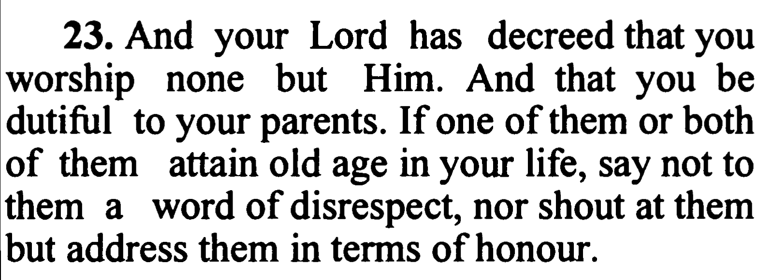

Slide 46
Showing humility and gratitude to parents
Children must show humility, respect, mercy and compassion to their parents. In the Holy Qur’an Almighty Allah says (Surah 17 Ayat 24):

Slide 47
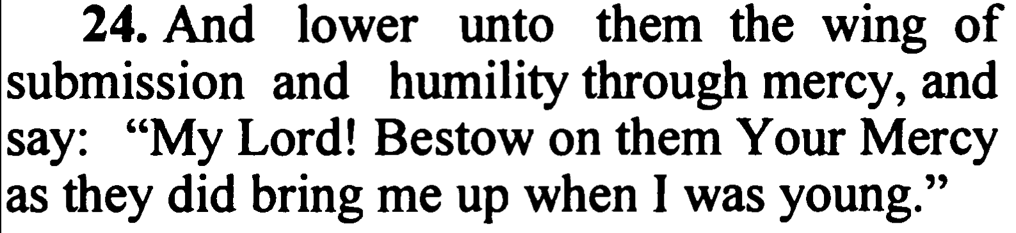

Slide 48
Thanks
THANK YOU!!!

